Slide 1

UMBC Cyber Defense Team
Brief Overview of the Club
2019-2020
Notes:
Kevin

Slide 2


Welcome to the UMBC Cyber Defense Club!
Also called the UMBC Cyber Dawgs!
A student run organization since 2009.
We’re a group of students that share a passion for and recognize the importance of computer security
such hack
much cyber

Slide 3
Track #1: Education and Hands-on
Our regular club meetings: every Wednesday; 7-9 in PUP105
We have a schedule for this semester!
Check it out on our website: http://umbccd.umbc.edu/
Some stuff we’ll be covering this semester:
Web exploitation
Networking basics
Offensive security
Notes:
Kevin

Slide 4
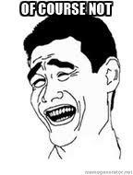
This all sounds super cool…but do I need to have experience coming in?
Schedule is tailored for beginners and veterans alike.
Having trouble/can’t find a solution? Ask us!
Bored/already know it? ASK US!!!
This is a club, not a lecture hall, so even if you already know the topic, please come by and hang out, and help people if you are inclined.
This semester, we also have CMSC 491/791!
Most of our resources are available on our GitHub as well: https://github.com/UMBCCyberDawgs
Notes:
Kevin

Slide 5
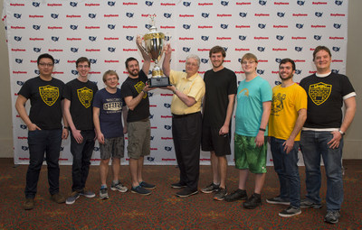
Track #2: Competition Participation
We encourage EVERYONE to do at least one competition while they’re part of the Cyber Dawgs
Formal requirement for the 491/791 class
We’ve done pretty well in the past… join us!
NCCDC Champions 2017
ISTS Champions 2019
CSAW North American Trivia Division Champions 2017/2018
Notes:
Zack
What the club was founded on
We do both CTFs and defense competitions, covering offense and defense

Slide 6
Some Upcoming Competitions
PicoCTF is always running, it’s an introductory CTF
New version comes out: 9/27/19 - 10/11/19 https://picoctf.com/
CSAW CTF (Cyber Security Awareness Week): Qualifiers begin September 13th!
We’ll be playing as a group. This is one of the harder collegiate-level CTFs, but feel free to join anyway!
CyberSkyline Metropolis CTF (hosted at UMD College Park)
Teams of 4, we’ll be organizing in the coming weeks
Others: Kaizen, NCL, Parsons CTF, Cyberforce, ISTS, CCDC (of course!)

Slide 7
CSAW Information
Qualifiers begin Friday at 4PM, runs until Sunday, 4PM
We will be meeting up at 3:30ish on Friday on the second floor of ITE
Categories include Web Exploitation, Cryptography, Binary Reverse Engineering, Binary Exploitation, Miscellaneous
If you don’t have existing experience with assembly or writing web apps, you may have a frustrating time. That said, you’re welcome to attend if you promise me that you’ll try at least one other CTF before you give up :)
DM me (seamus) on Slack if you get a flag, so I know who our top performers are to make the Finals team (4 people) if we qualify
Notes:
Saturday times are TBD, depends on interest (I’m not leaving my apartment if no one is here)
You can compete remotely, but it’s not as fun, and Slack only has the pizza emoji, not the pizza.
Do not register your own account, I have already registered us. I’ll post the password on Friday

Slide 8
Oh…and WE are hosting our own Competitions!
October 19th: Cyber Defense Exercise!
Virtually required to make the CCDC team -- show off your knowledge and drive (or learn if you don’t have knowledge yet)
April 11th: DawgCTF!
Great events for beginners and veterans alike
There will be prizes for top performers!!!
There will also be some companies to network with!

Slide 9





Track #3: Industry Exposure
We’ll have some industry folks come in and give talks, demos, labs, and host competitions!
Our current sponsors:
Parsons
Tensley Consulting
Rapid7
Novetta
Blue Star Software
Notes:
Kevin

Slide 10
YEEHAW!!! I’M TOTALLY HOOKED!
Remember: our regular club meetings are Wednesdays from 7pm-9pm in PUP105.
Get on our slack channel! https://umbccd.slack.com
This is really the best way to communicate with us, so get on this ASAP!
Check out our website to see our schedule, resources page, and link up with the group at http://umbccd.umbc.edu/
Subscribe to our mailing list: send an email to umbccd-group+subscribe@umbc.edu to join (umbc email only)
Notes:
Slack

